Slide 1
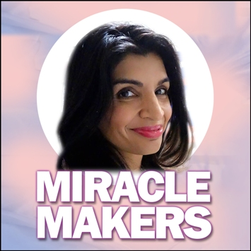

Slide 2
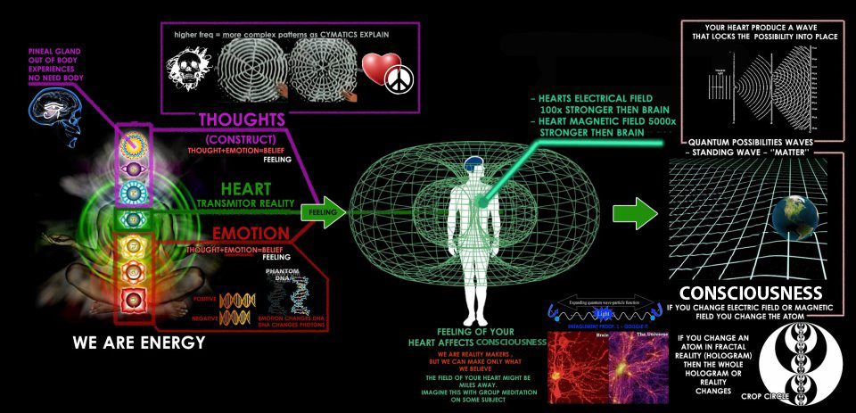

Slide 3
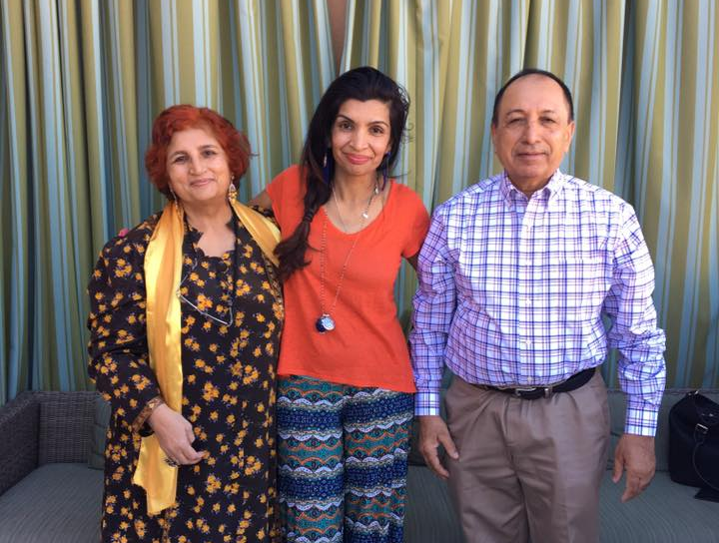

Slide 5
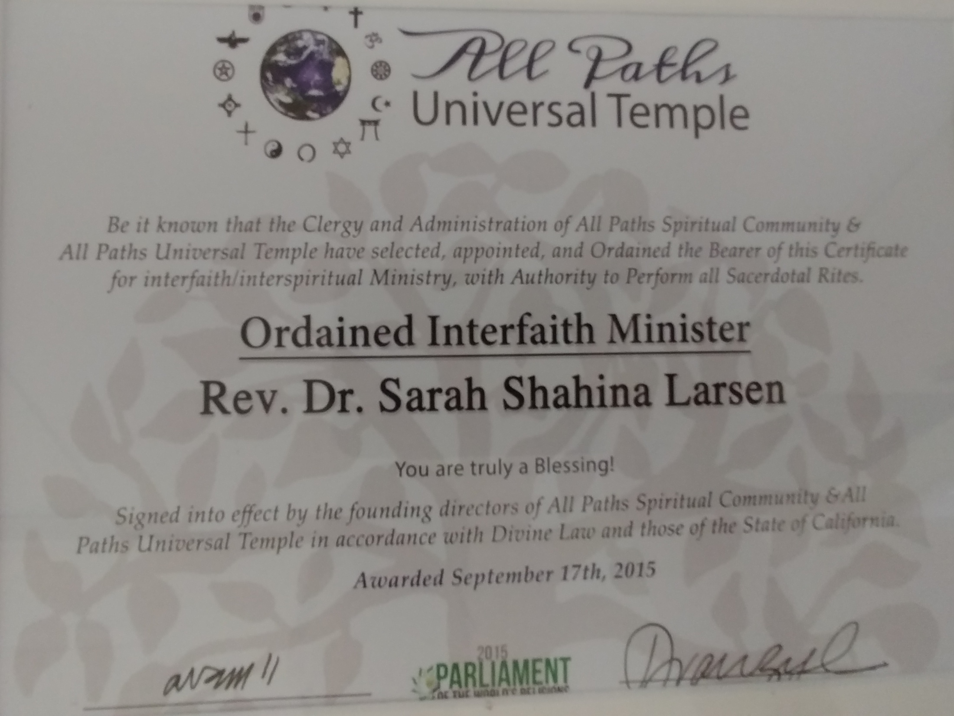

Slide 6
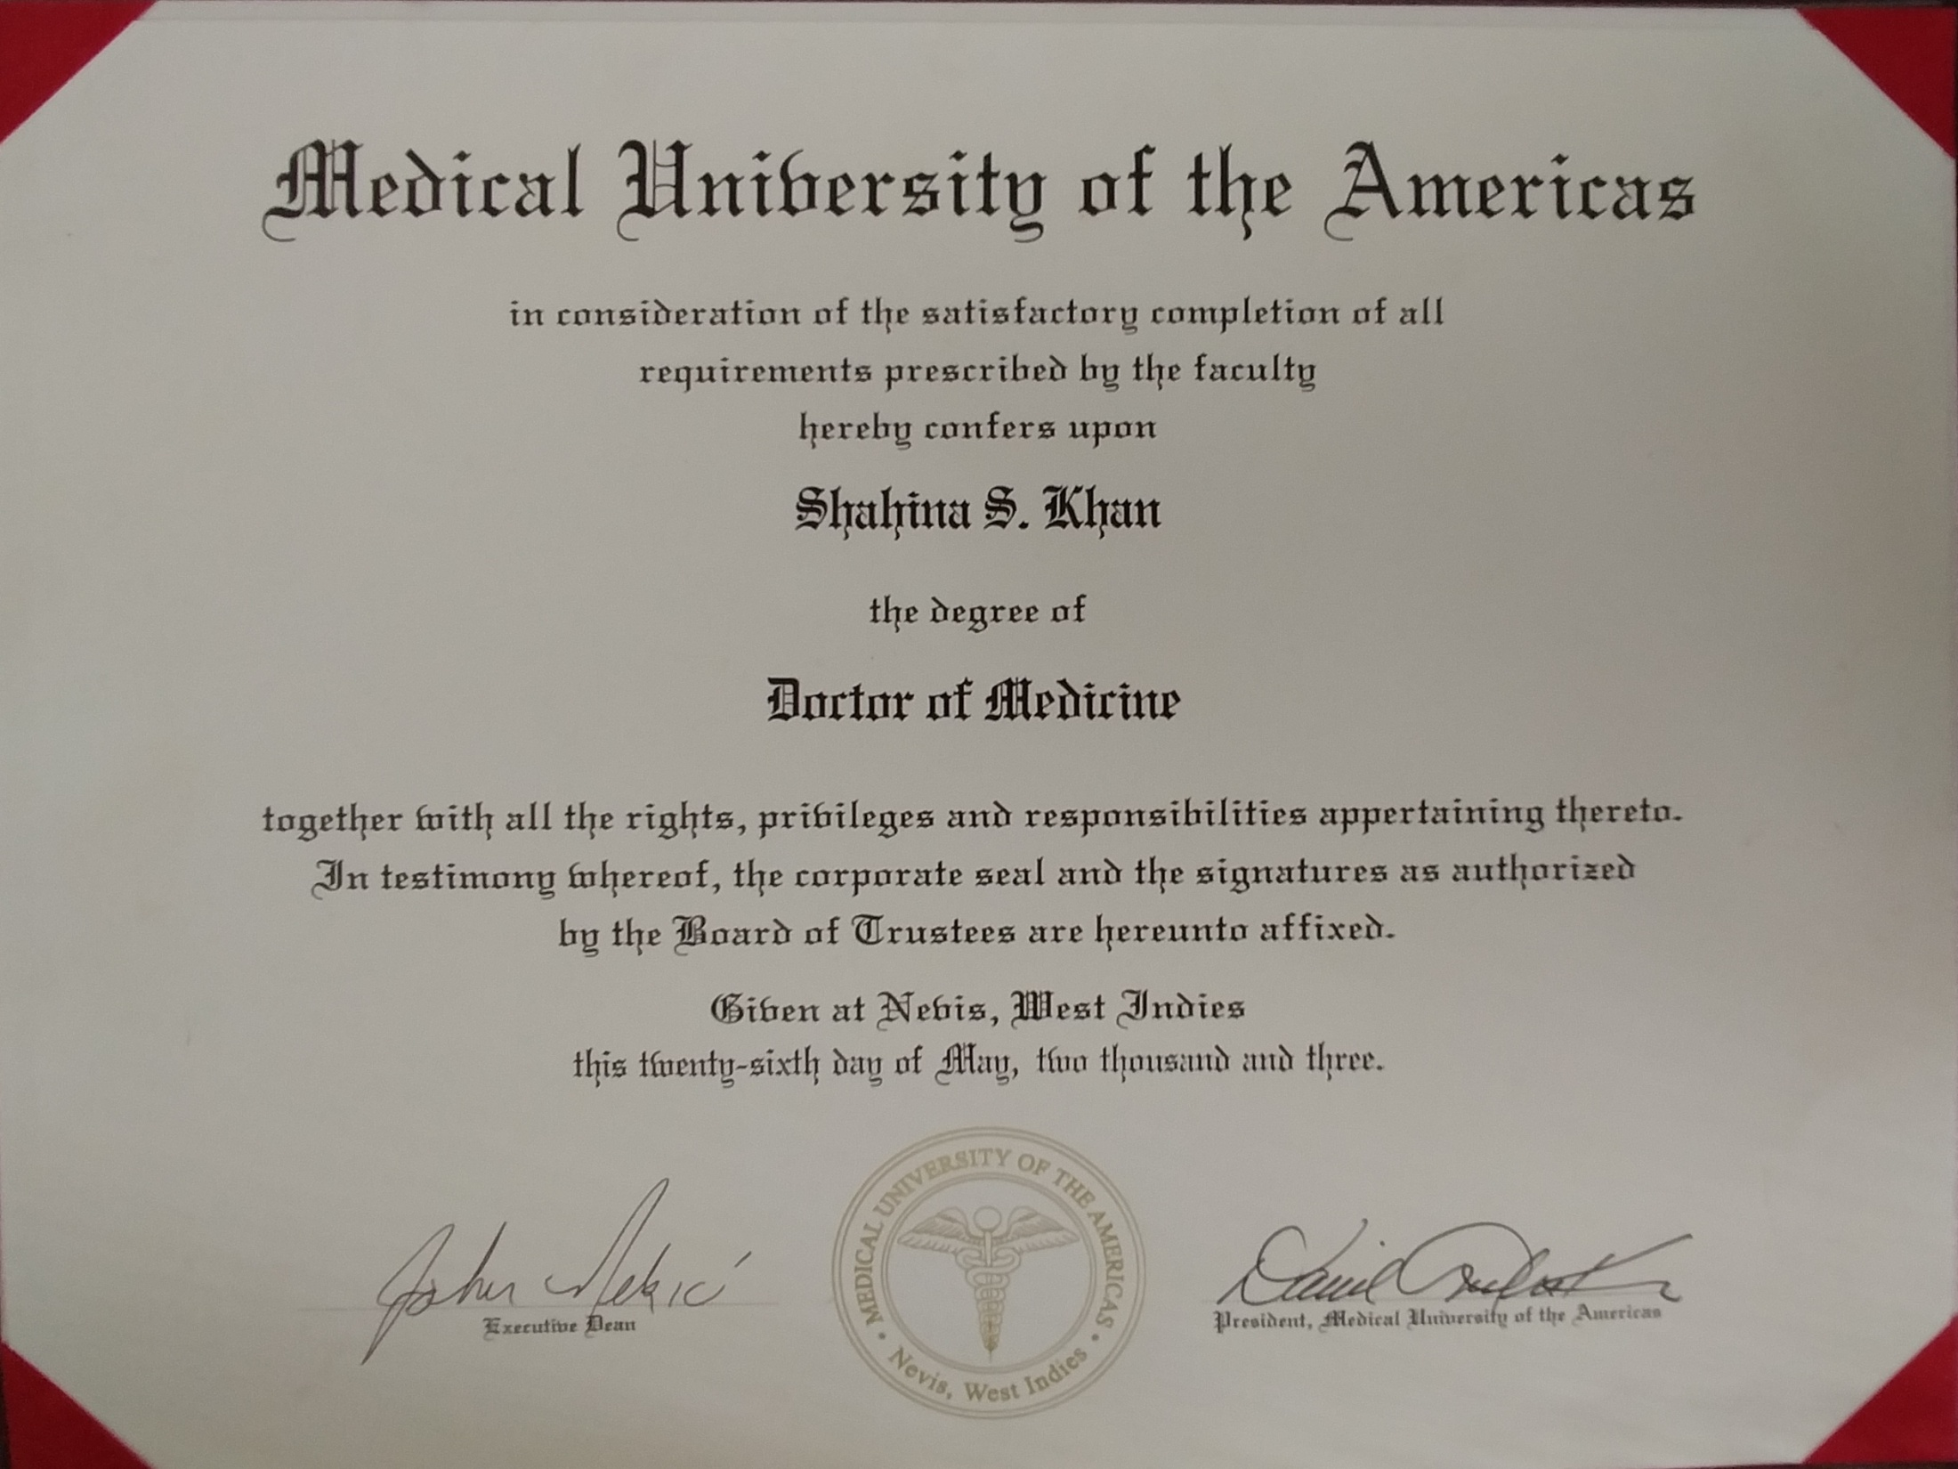

Slide 7
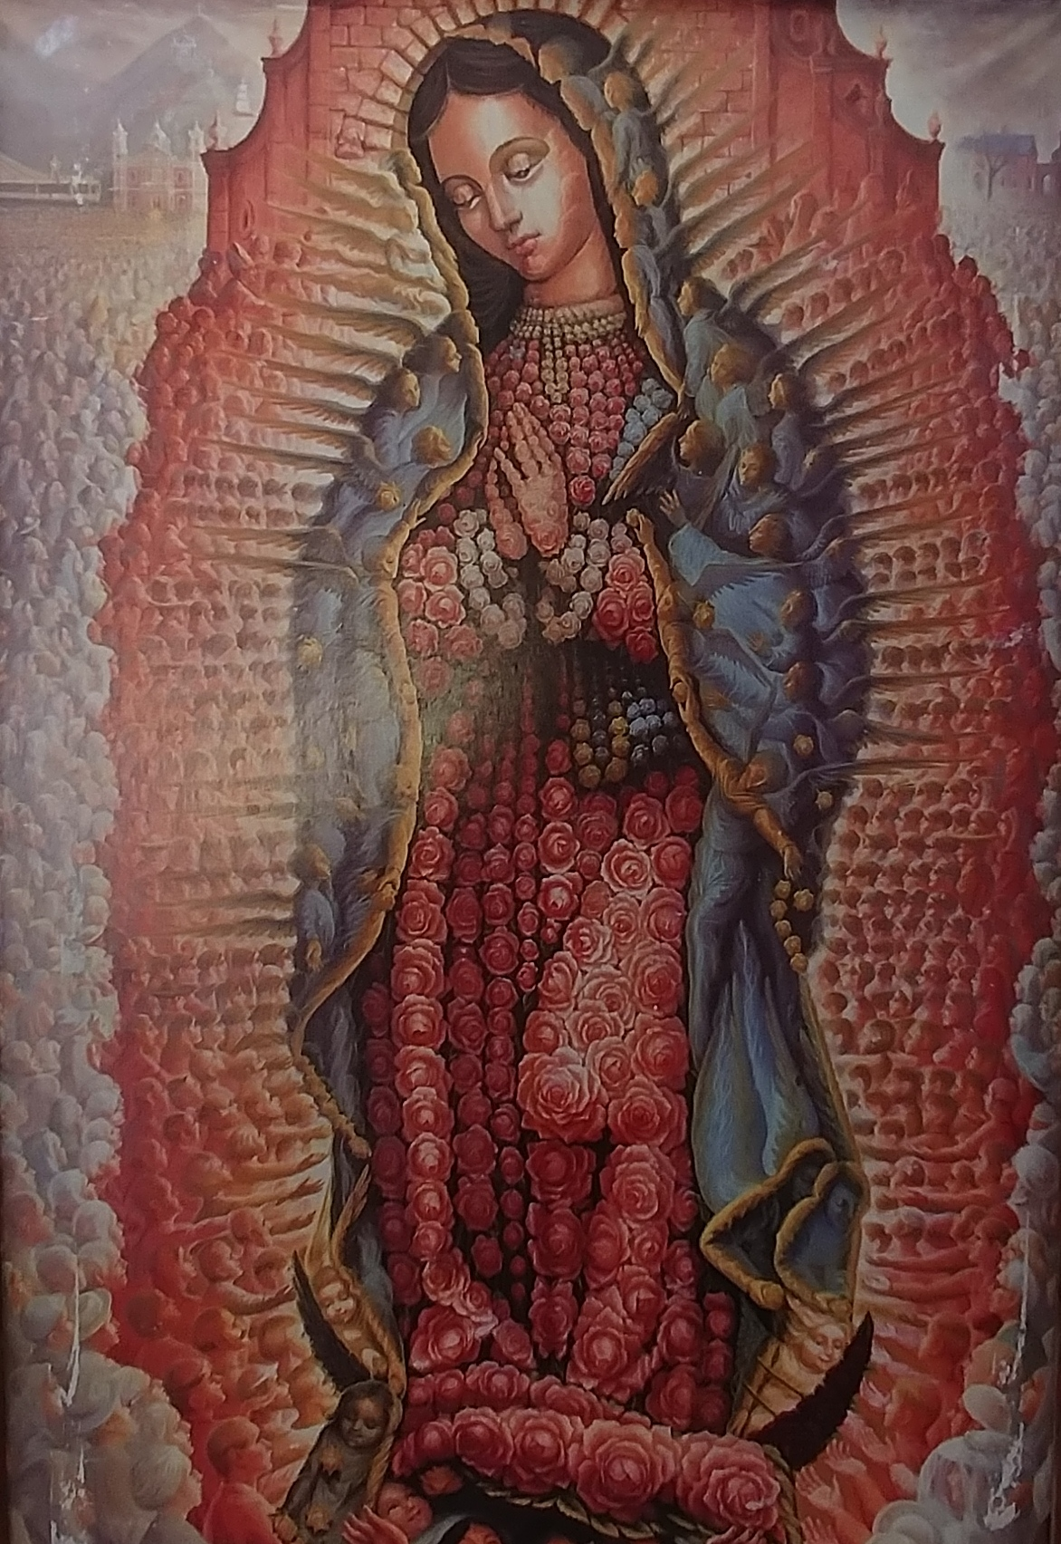

Slide 8
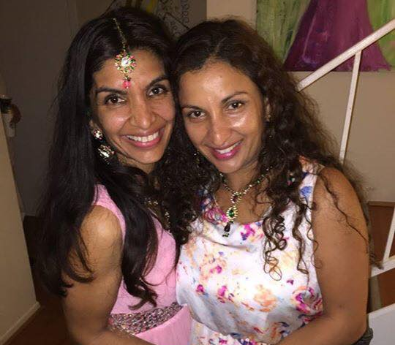

Slide 9
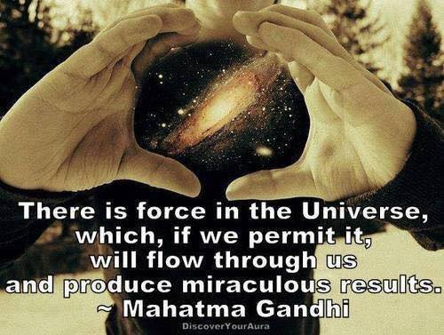

Slide 11
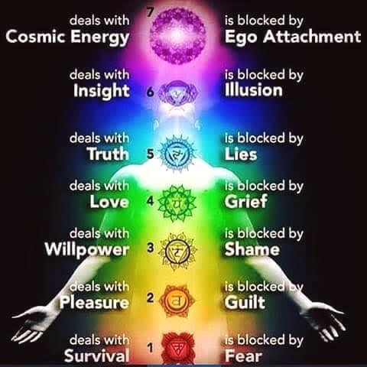

Slide 13
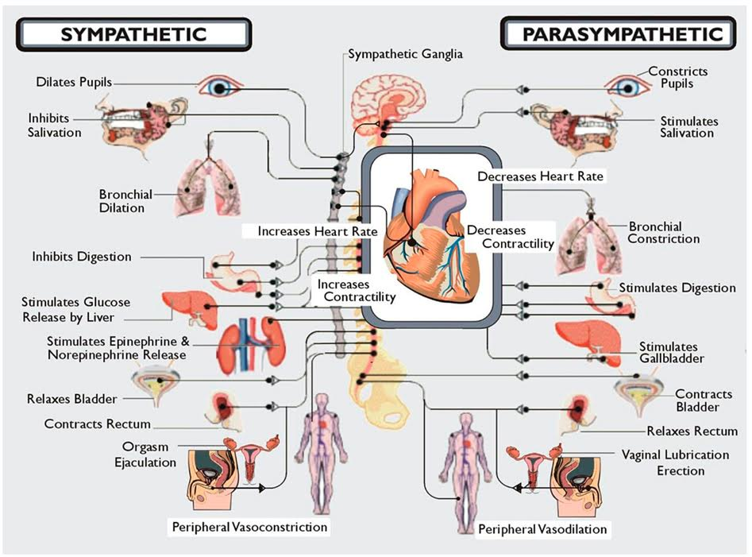

Slide 15
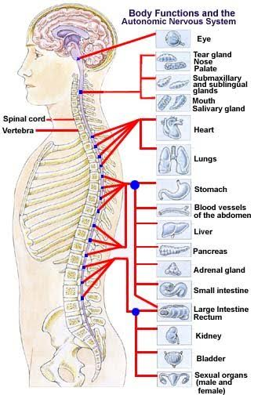

Slide 16
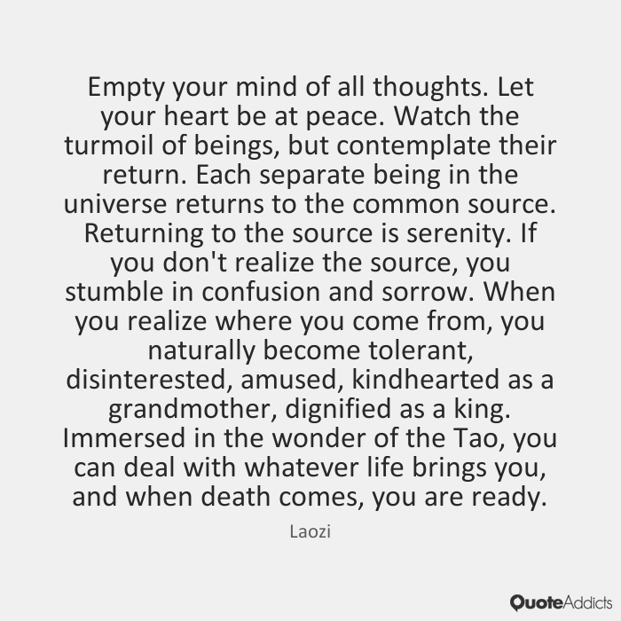

Slide 17
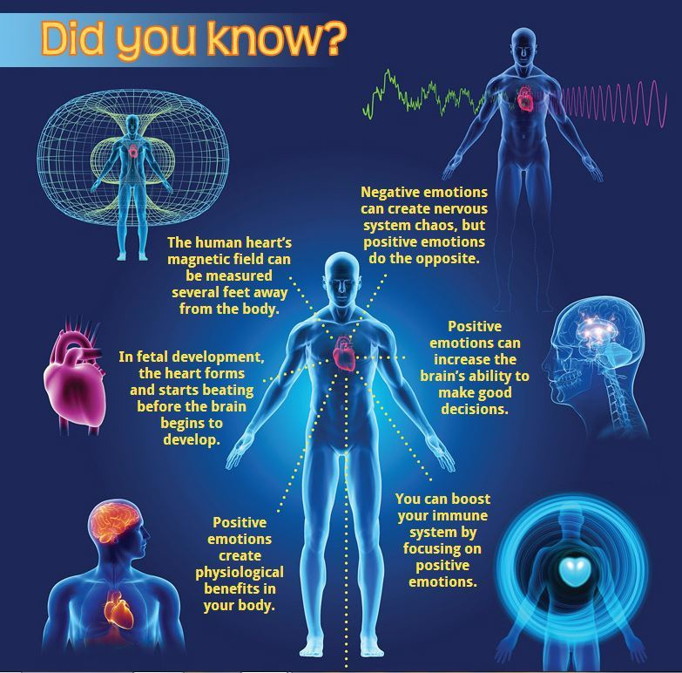

Slide 18
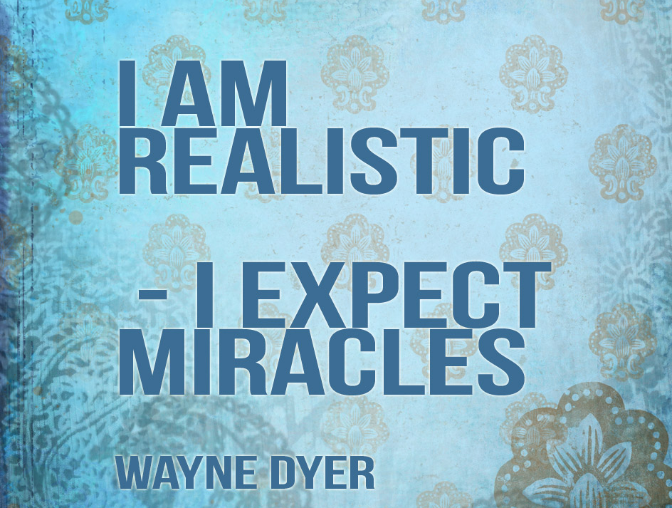

Slide 21
Transform Your Energy Body for Success
10-week Miracle Maker Mastermind
You can move forward powerfully, successfully, and confidently in your own life. Dr. Sarah’s full toolkit for intuitive transformation will be at your disposal along with fun exercises and processes. These teachings will empower you to take greater responsibility for your life and success.
You will transform:
Your health and success beliefs
How you experience miracles
The old cells to the new cells
Your relationship and friendships
How you share your gifts
Your life with an expanded life purpose
Your success and income set point
Two 10-week Masterminds will be hosted simultaneously. In person or via Zoom
Mondays – starting May 8th in Marina Del Rey
Sundays – starting May 14th in Northridge
Your Investment: $1000

