Slide 1
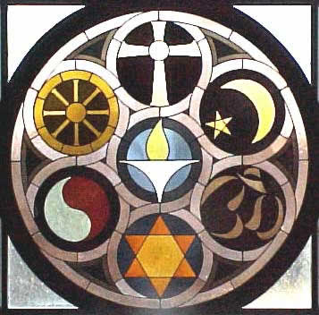
7 MAJOR WORLD RELIGIONS

Slide 2
WHAT DEFINES A RELIGION?
A religion consists of supernatural power or powers that are regarded as the creators and maintainers of the universes
Religion establishes beliefs and values that define how people worship the divine being or divine forces
All 7 major world religions are defined by 3 types:
Monotheistic: belief in ONE god (mono=1)
Polytheistic: belief in MANY gods (poly=many)
Animistic: belief in divine forces in nature (anima-soul)

Slide 3
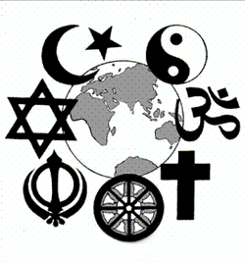
RELIGION SPREADING
Religion is a form of cultural diffusion
Spreading of new ideas
Converts are people who give up their former beliefs for a new religion
Some religions actively seek to convert followers
At times uses acts of violence
Some religions are found in isolated parts of the world that center their beliefs around their surrounding (animism)

Slide 4
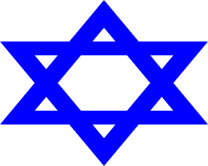
JUDAISM
SYMBOL
WHO DISCOVERED RELIGION? | Abraham, Moses
WHEN | 3,000 B.C.
WHERE | Israel
HOLY BOOK(S) / HOUSE OF WORSHIP | Torah, Talmud Synagogues
MAJOR DIVISION | Orthodox, Conservative, Reform
FOLLOWERS | Jews; 14 Million
BASIC BELIEF | Monotheistic Jews are the chosen people of God, must follow his laws Jerusalem / Israel are holy land

Slide 5
CHRISTIANITY
SYMBOL
WHO DISCOVERED RELIGION? | Abraham, Jesus
WHEN | 30 A.D.
WHERE | Israel
HOLY BOOK(S) / HOUSE OF WORSHIP | Old Testament (Judaism), New Testament (Stories of Jesus) Church
MAJOR DIVISION | Catholic, Protest, Orthodox
FOLLOWERS | Christians; 2 Billion
BASIC BELIEF | Monotheistic Jesus Christ is the son of God Death and resurrection Came to redeem mankind from sin Ten Commandants

Slide 6
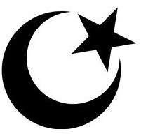
ISLAM
SYMBOL
WHO DISCOVERED RELIGION? | Abraham, Mohammad
WHEN | 620 A.D.
WHERE | Arabian Peninsula
HOLY BOOK(S) / HOUSE OF WORSHIP | Quran, Hadith Mosque
MAJOR DIVISION | Sunni, Shia
FOLLOWERS | Muslims, 1.3 Billion
BASIC BELIEF | Monotheistic There is no god but Allah, and Muhammad is the messenger of God Five Pillars of Islam

Slide 7
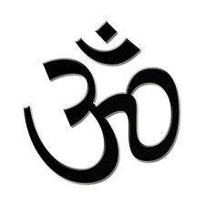
HINDUISM
SYMBOL
WHO DISCOVERED RELIGION? | Ancient priests of India
WHEN | 5,000-3,000 B.C.
WHERE | India
HOLY BOOK(S) / HOUSE OF WORSHIP | Vedas Temple
MAJOR DIVISION | Numerous schools and traditions
FOLLOWERS | Hindus, 900 Million
BASIC BELIEF | Polytheistic Reincarnation (rebirth) Karma-a person's actions in this and previous states of existence, viewed as deciding their fate in future existences Ultimate Goal-oneness with “Brahman” (God, Reality)

Slide 8
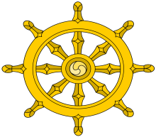
BUDDHISM
SYMBOL
WHO DISCOVERED RELIGION? | Siddhartha Gautama (Buddha)
WHEN | 500 B.C.
WHERE | Northern India
HOLY BOOK(S)/ HOUSE OF WORSHIP | Tripitaka Monastery
MAJOR DIVISION | Mahayana, Theravada
FOLLOWERS | Buddhist, 360 Million
BASIC BELIEF | Polytheistic Life is suffering, caused by wanting things, caused by ignorance Reincarnation and Karma Dharma- is the path of righteousness and living one's life according to the codes of conduct 8-Fold Path allows escape to Nirvana -state in which there is neither suffering, desire, nor sense of self, and the subject is released from the effects of karma and the cycle of death and rebirth. It represents the final goal of Buddhism

Slide 9
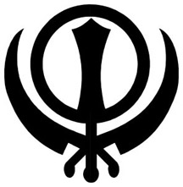
SIKHISM
SYMBOL
WHO DISCOVERED RELIGION? | Guru Nanak
WHEN | 1500 A.D.
WHERE | India, Pakistan
HOLY BOOK(S) / HOUSE OF WORSHIP | Adi Granth Temple
FOLLOWERS | Sikhs; 23 Million
BASIC BELIEF | Monotheistic Mixture of Islam and Hinduism Believe in Reincarnation and Karma Kesh - uncut hair and beard, as given by God, to sustain him or her in higher consciousness; and a turban, the crown of spirituality. Kangha - a wooden comb to properly groom the hair as a symbol of cleanliness. Katchera - specially made cotton underwear as a reminder of the commitment to purity. Kara - a steel circle, worn on the wrist, signifying bondage to Truth and freedom from every other entanglement. Kirpan - the sword, with which the Khalsa is committed to righteously defend the fine line of the Truth.

Slide 10
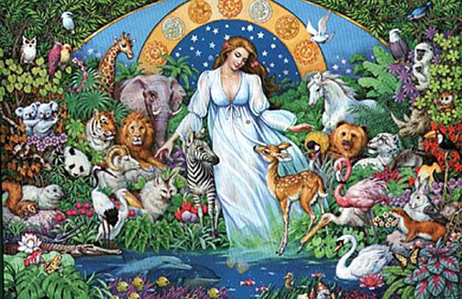
ANIMISM
Retained tribal ethnic religion of people around the world
Today adherents number at least 100 million
Animists believe certain inanimate objects posses spirits or souls
Spirits live in rocks, rivers, mountain peaks, and heavenly bodies of water
Each tribe has its own unique characteristics
Mostly found in Sub-Saharan Africa

Slide 11
